Slide 1
Monitoring & Securing a Web Application

Slide 2
Description of the Project
Monitoring a web application encompasses the continuous observation and analysis of its performance, behavior, and security. This involves tracking metrics to ensure the application operates efficiently and can handle expected loads, managing logs to detect and diagnose issues or unusual activity, setting up alerts to be notified of potential problems or security incidents, and analyzing these alerts and logs to respond to and mitigate any detected issues or threats.
Securing a web application in the AWS cloud involves implementing a range of measures and controls to protect it from unauthorized access, breaches, and other cyber threats. This process includes managing who can access the application and its resources, ensuring that data is encrypted both in transit and at rest, identifying and addressing security vulnerabilities, and employing strategies to prevent common attacks.

Slide 3
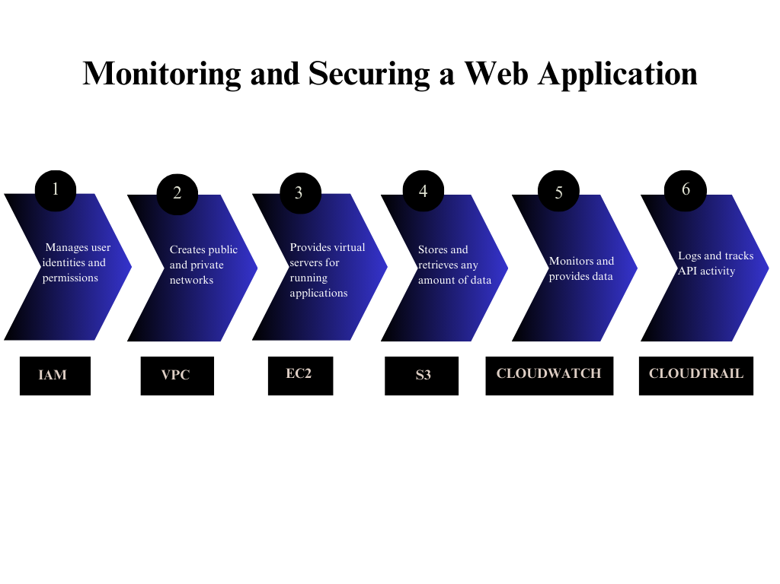
Flowchart of the Project

Slide 4
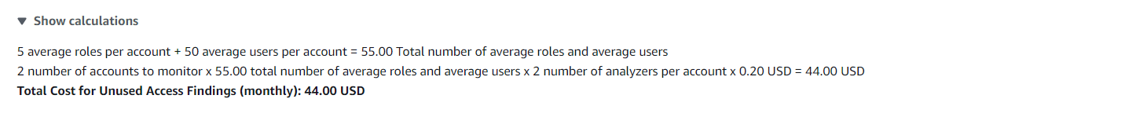
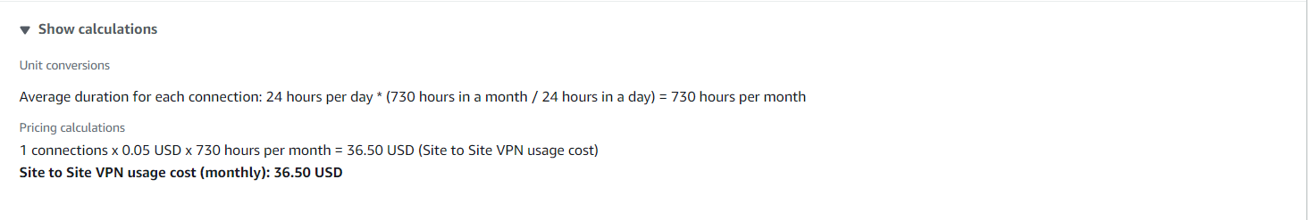
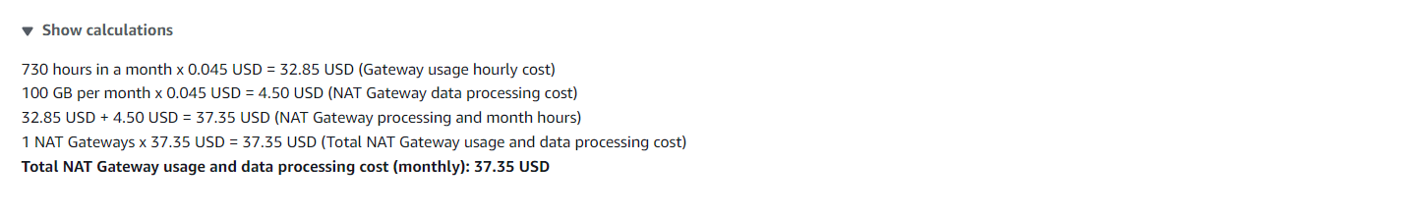
Pricing of the Project
IAM
VPC
VPC (NAT Gateway)

Slide 5
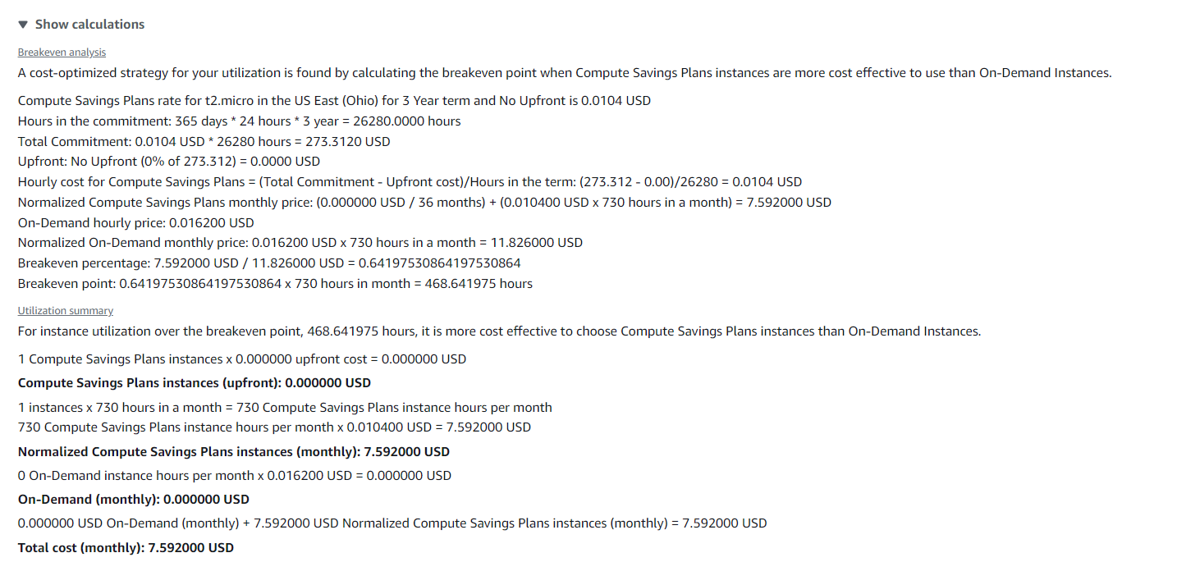
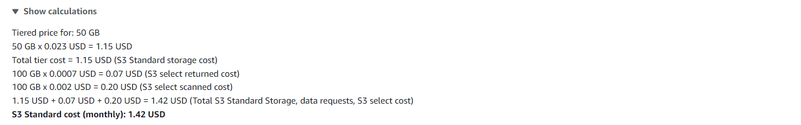
EC2
S3

Slide 6
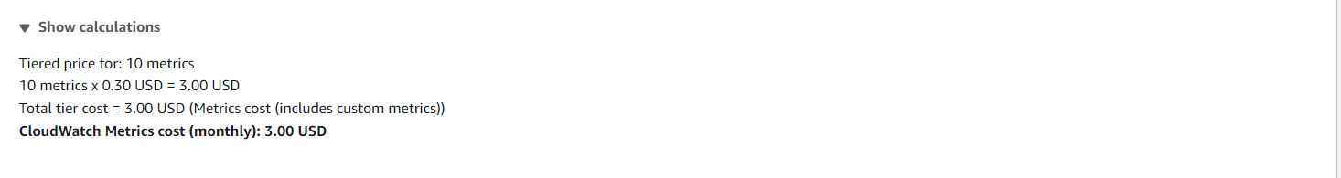
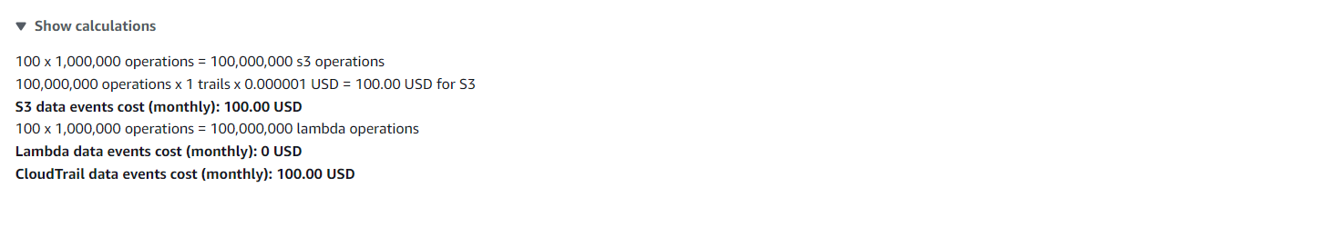
CloudWatch
CloudTrail

Slide 7
Services used for Project
1.IAM (Identity & Access Management)
- Users
2.VPC (Virtual Private Cloud)
- VPC & Subnets
- Internet Gateway & NAT Gateway
- Route Tables
3.EC2 (Elastic Compute Cloud)
- Security Groups
- Instance
4.S3 (Simple Storage Service)
- Bucket

Slide 8
5.Amazon Cloud Watch
- Metrics
- Widgets
6. Cloud Trail logs
- Trail
- Logs

Slide 9
1.Sign-in to AWS Root Account
1.Search for AWS Management Console in Browser.
2.Open to the AWS Management Console.
3.Click on “Sign In to the Console”.
4.Choose “Root user” as the login method.
5.Enter Email and Password that is associated with your AWS root account.
6.Click on Sign in.

Slide 10
2.SETTING UP IAM
1.Open AWS dashboard in AWS Management Console.
2.Search for IAM in Search bar and open IAM dashboard.
3.Go to Users and create the number of users based on your requirement ,we don’t have the requirement to create a Group as of now, because we are creating a single IAM user.
4.Configure the name of the user , and Click on Checkmark - Custom password and Click on Checkmark User must create a new password at next sign-in.
5.Now Select - Attach Policies Directly in Permission Options and Search the required permissions for the IAM user account that we are creating.
6.Now we are Selecting required permissions to our IAM user based on our project requirements in Permissions Policies.
7.IAM Full Access , AmazonEC2FullAccess , AmazonVPCFullAccess , AmazonS3FullAccess, CloudWatchFullAccess , AWSCloudTrail_FullAccess.
8.After selecting the permissions click on Create user.

Slide 11
3.SETTING UP VPC
1.Open AWS dashboard in AWS Management Console.
2.Search for VPC in Search bar and open VPC dashboard.
3.Click on create VPC ,Now select VPC only in VPC Settings and give a name to your VPC.
4.Select IPV4 CIDR – (10.0.0.0/24 , the block size is 64 Class C), and click on Create VPC.
5.In VPC dashboard now click on Subnets(We require 2 subnets based on requirement).
6.Select the created VPC in VPC ID , while creating subnet - Subnet 1 was created with subnet name as public1 , under the region us-east-1a, IPv4 VPC CIDR Block :10.0.0.0/24, IPv4 Subnet CIDR Block 10.0.0.32/27 .
7.Subnet 2 was created with subnet name as private1 under the region us-east-1b , IPv4 VPC CIDR Block :10.0.0.0/24, IPv4 Subnet CIDR Block 10.0.0.64/27 .
8.Two Subnets are successfully created in your VPC.

Slide 12
4.Setting Up Internet Gateway
1.In VPC dashboard ,Select Internet Gateway.
2.Create an Internet Gateway, give a name in name tag in internet gateway setting.
3.Create the Internet Gateway.
4.Click on the pop up or click on actions in top right corner to Attach to a VPC.
5.Select already created VPC in Available VPC’s and click on Attach Internet Gateway.
6.Internet Gateway is successfully attached to the existing or created VPC.

Slide 13
5.Setup Default Route table of VPC
1.While creating VPC , a default RouteTable is created, Each subnet in your VPC is associated with a route table which controls the traffic flow between subnets.
2.Give a name as smwroute1 to the default created Routetable.
3.Select the default Route table - smwroute1
4.Click on Routes ,Click on edit route and add route – Choose 0.0.0.0 in left dropdown & Choose Internet Gateway in Right dropdown and exactly down to it select created Internet Gateway.
5.Click on Save changes.
6.Click on Subnet Associations , Click on edit Subnet Associations & select the public subnet created under VPC and Click on save changes.
7.Now we successfully updated the Routes and Subnet Associations of Default Route Table

Slide 14
6.Setting up NAT Gateway
1.Open NAT Gateways in VPC Dashboard.
2.Click on Create an NAT Gateway , give name to the NAT Gateway as smwNATgw.
3.Select public1 subnet, & Click on Save associations.
4.Click on Create NAT Gateway.
5.Open Route table in VPC Dashboard, Create a new route table with name as smwroute2.
6.Select the created VPC & Create Route Table.
7.Select the newly created Route Table , Click on Routes.
8.Click on edit route and add route – Choose 0.0.0.0 in left dropdown & Choose NAT Gateway in Right dropdown and exactly down to it select created NAT Gateway.
9.Click on Save changes.
10.Click on Subnet Associations , Click on edit Subnet Associations & select the private1 subnet created under VPC and Click on save changes.
11.Now we successfully updated the Routes and Subnet Associations of Default Route Table

Slide 15
7.Setting Up Security Group & EC2
1.Open AWS dashboard in AWS Management Console , Search for EC2 in Search bar and open EC2 dashboard , In the left-hand menu, select Security Groups under Network & Security.
2.Click on Create security group , Under Name tag enter a name for your security group , Provide a description for your security group in description box.
3.In VPC ,select the created VPC ,
Add Inbound Rules : Click Add rule to define rules for inbound traffic , Select the SSH type of connection under Type. The protocol used is TCP Under Port Range enter the port number, 22 for SSH. Define the allowed IP ranges in Source, 0.0.0.0/0 for all IPs.
Add Outbound Rules: By default, all outbound traffic is allowed.
4.Click Create security group.

Slide 16
EC2
1.Open AWS dashboard in AWS Management Console , Search for EC2 in Search bar and open EC2 dashboard , In the left-hand menu, click on Instances.
2.Click on Launch Instance , Give name for instance & Select an AMI from the list - Microsoft Windows Server 2022 Base is selected.
3.Select the instance type -t2micro, Select a Key Pair-Choose an existing key pair or create a new one.
4.Adjust settings like the number of instances, network, and subnet.
5.Under Network Settings : Select the VPC and Subnets we already created and Enable Auto-assign public IP.
6.Now Configure Security Group, Select an existing security group.
7.Review the configuration of your instance & Click Launch Instance.
8.Click View Instances to see your newly created instance in the EC2 Dashboard.

Slide 17
8.Setting up S3 bucket
1.Open AWS dashboard in AWS Management Console.
2.Search for S3 in Search bar and open S3 dashboard, Click on Create Bucket.
3.Select the bucket type as General Purpose, Give Unique bucket name to your bucket.
4.Checkmark on Block All public Access, Select ACL’s disable in Object Ownership & Create on Bucket.
5. Select the S3 Bucket ,Click on Objects ,Click on Upload & Choose the files from your PC.
6.Click on file to be uploaded and Click on Upload.
7.When we use the Object URL of this file in S3 bucket it will be only available for your Private users.
8.If the Public Users wants to access the website.
9.Select the file in S3 bucket ,Click on permissions, Uncheck mark the “Block all public access” to convert into Public ,Copy the Bucket ARN number & Click on Edit on Bucket Policy.

Slide 18
10.Select S3 bucket policy in Select Policy type ,Click on Allow Effects & Type * in Principles.
11.Check mark All Actions , Paste the Bucket ARN and enter /* after Bucket ARN.
12.Click On Add Statement & Click on Generate Policy.
13.Copy the code from AWS Policy and Paste it in Bucket Policy & Save it.
14.Bucket Policy edited Successfully.
15. Now public users can access our website by Object URL.

Slide 19
9.Setting up Cloud Watch
1.Open AWS dashboard in AWS Management Console.
2.Search for Cloud Watch in Search bar and open Cloud Watch dashboard.
3.In the left-hand menu, click on Dashboards & Click on Create dashboard , Create Custom Dashboard.
4.Enter a name for your dashboard in the Dashboard name field & Click Create dashboard.
5.After creating the dashboard, you’ll be prompted to add widgets , Click Add widget & Choose the type of widget you want to add.
6.Select the Data type - Metrics in Widget Configuration. Choose the metrics you want to display. You can select metrics from various AWS services or custom metrics. Click Next.
7.In Add query select the service you need to monitor , here we selected EC2 and select one from the given options for the representation based on the CPU utilization of the instance.
8.In Browse paste the Instance id , Select the instance need to be monitored and click on Add widget.
9.After you’ve added and configured all your widgets, click on Save dashboard to save your changes.
10.Once you click on save dashboard you can view the graphical visualization of the Instance Monitoring.

Slide 20
10.Setting up Cloud Trail
1.Open the AWS Management Console , Search for Cloud Trail & Open.
2.In the Cloud Trail dashboard, click on Trails in the left-hand menu.
3.Click on Create Trail . Enter a name for your trail - security_monitoring_logs1 in the Trail name field. Click Create trail.
4.Now the Cloud trail is created & Logs are stored in S3 Bucket.

Slide 21
Conclusion
This project employs various AWS services to effectively monitor and secure a web application.
IAM ensures controlled access to resources, while VPC and subnets manage network isolation and organization.
NAT Gateway and Internet Gateway facilitate controlled internet access, and Route Tables direct network traffic.
Security Groups enforce traffic rules for enhanced security.
EC2 instances provide scalable computing power, and S3 Buckets store essential web files.
Cloud Watch Dashboards offer insights into application performance & Various graphs of monitoring Cloud Trail logs user activity for security and compliance.
This project is made for monitoring and securing any web application . So that Creator can watch the performance & logs of their website .This helps the website Creators and their company’s future.
THANK YOU..!

